Slide 1
Please view this presentation in “Slide Show” mode, it contains fancy animations.
Team Yellow Old Dominion University 9/23/2020
Load.In Feasibility Presentation 1

Slide 2
Load.in
Give your move a game plan.
Team Yellow
Feasibility Presentation
Old Dominion University
9/23/2020

Slide 3
Contents
Team Biography: 4-7
The Problem: 8-16
Problem Statement: 9
Problem Characteristics: 11-16
Current Process Flow: 17-19
Major Functional Component Diagram: 20-21
Competition: 22-23
References: 24
Glossary: 25

Slide 4
Who is Team Yellow?

Slide 5
Byron Aquilino
Lance Perdue
Gregory Kukanich

Slide 6
Jason Moran
Daniel Reyna
Chris Miller

Slide 7
Paul Rodriguez

Slide 8
Americans Prefer to Move Themselves

Slide 9
Professional Movers Are Costly
Based on 4 Movers at Average rate of $50/HR to $100/HR
https://www.mymovingreviews.com/move/average-moving-cost/

Slide 10
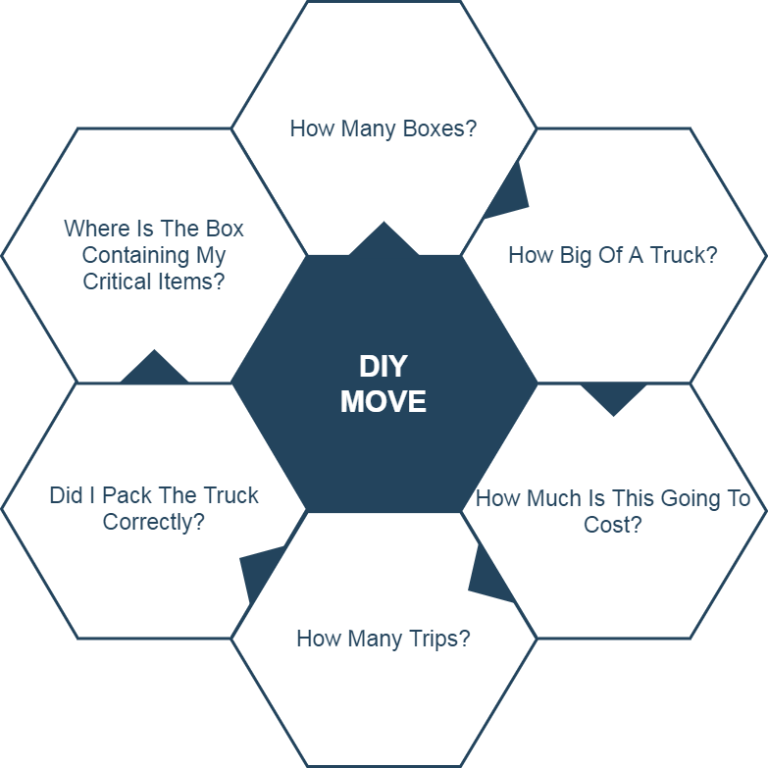
Moving is Challenging
These logistics make moving, which is already a stressful life event, even more stressful.

Slide 11
What are the characteristics of the problem?

Slide 12
78.3% of Americans go without the help of professional movers.
MoveBuddha.com

Slide 13
Accurately determining how big of a truck to get and how many trips a move will take is difficult. Rental Truck companies base their business model on this!
wtkr.com

Slide 14
Loading a truck properly requires many considerations including weight distribution and protecting fragile items.
PenskeTruckRental.com

Slide 15
Poor packing can result in property damage and in the worst case, a car accident. An estimated 50,000 accidents related to trailer towing occur each year.
Hayesbc.com

Slide 16
35% of Americans are stressed the most by logistics and packing.
Article.com

Slide 17
What is the current process?

Slide 18
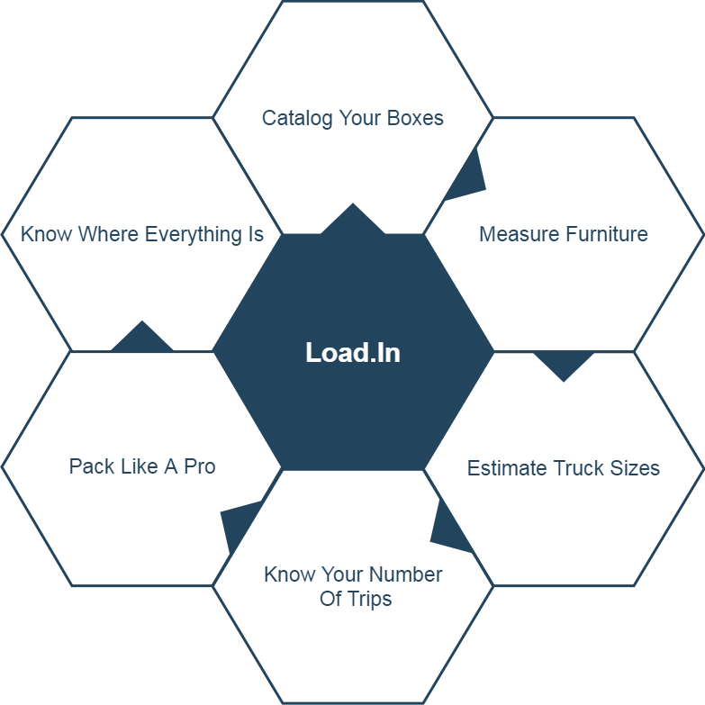
Solution Characteristics

Slide 19
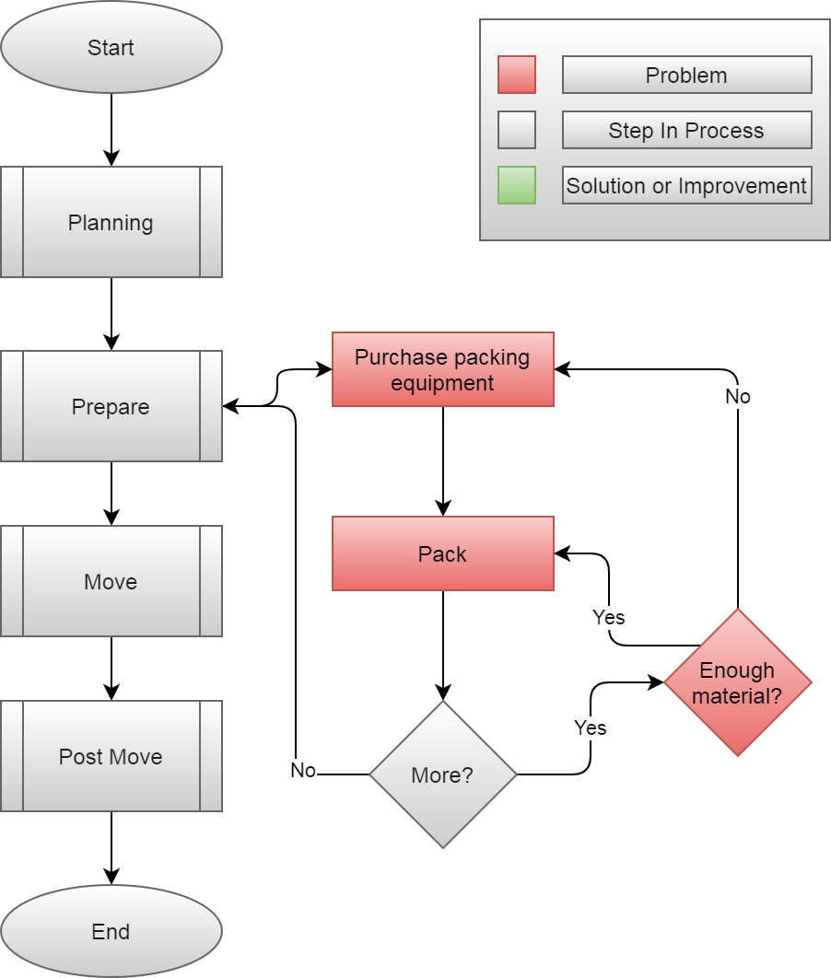

Slide 20
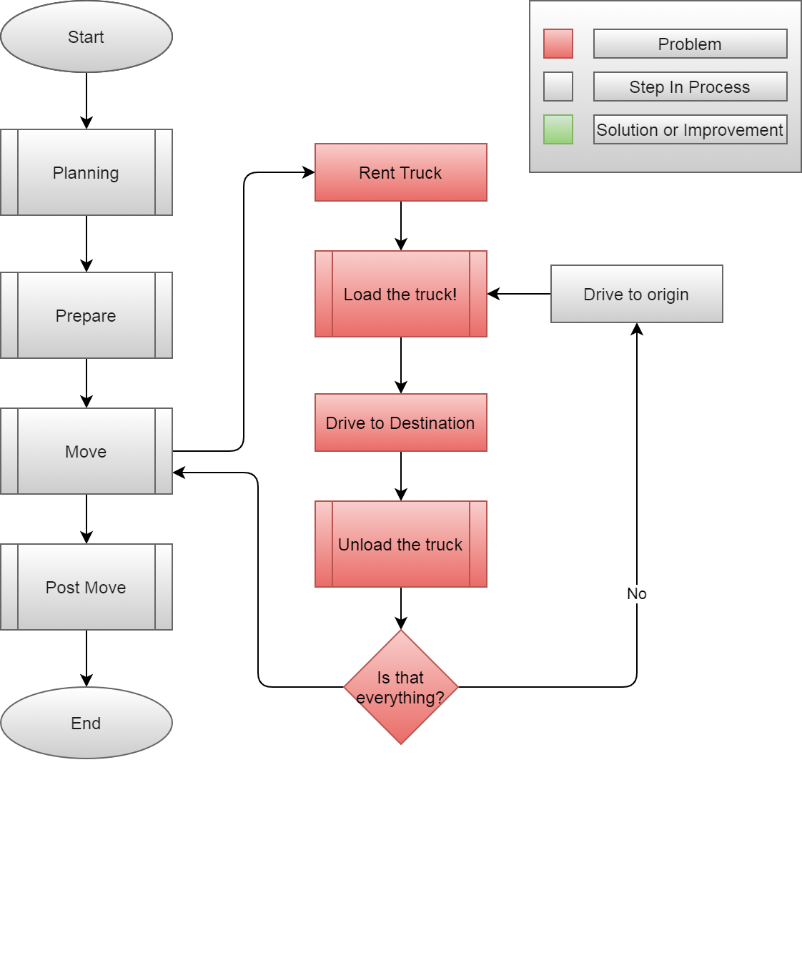

Slide 21
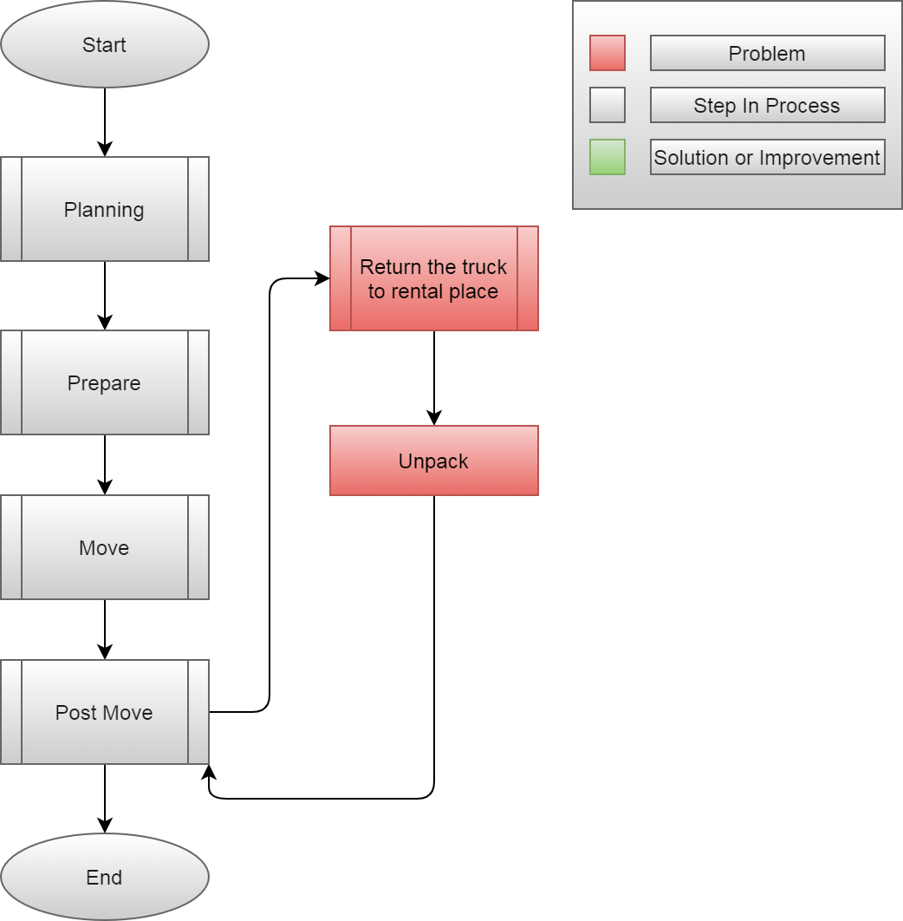

Slide 22
How will the solution help the process?

Slide 23
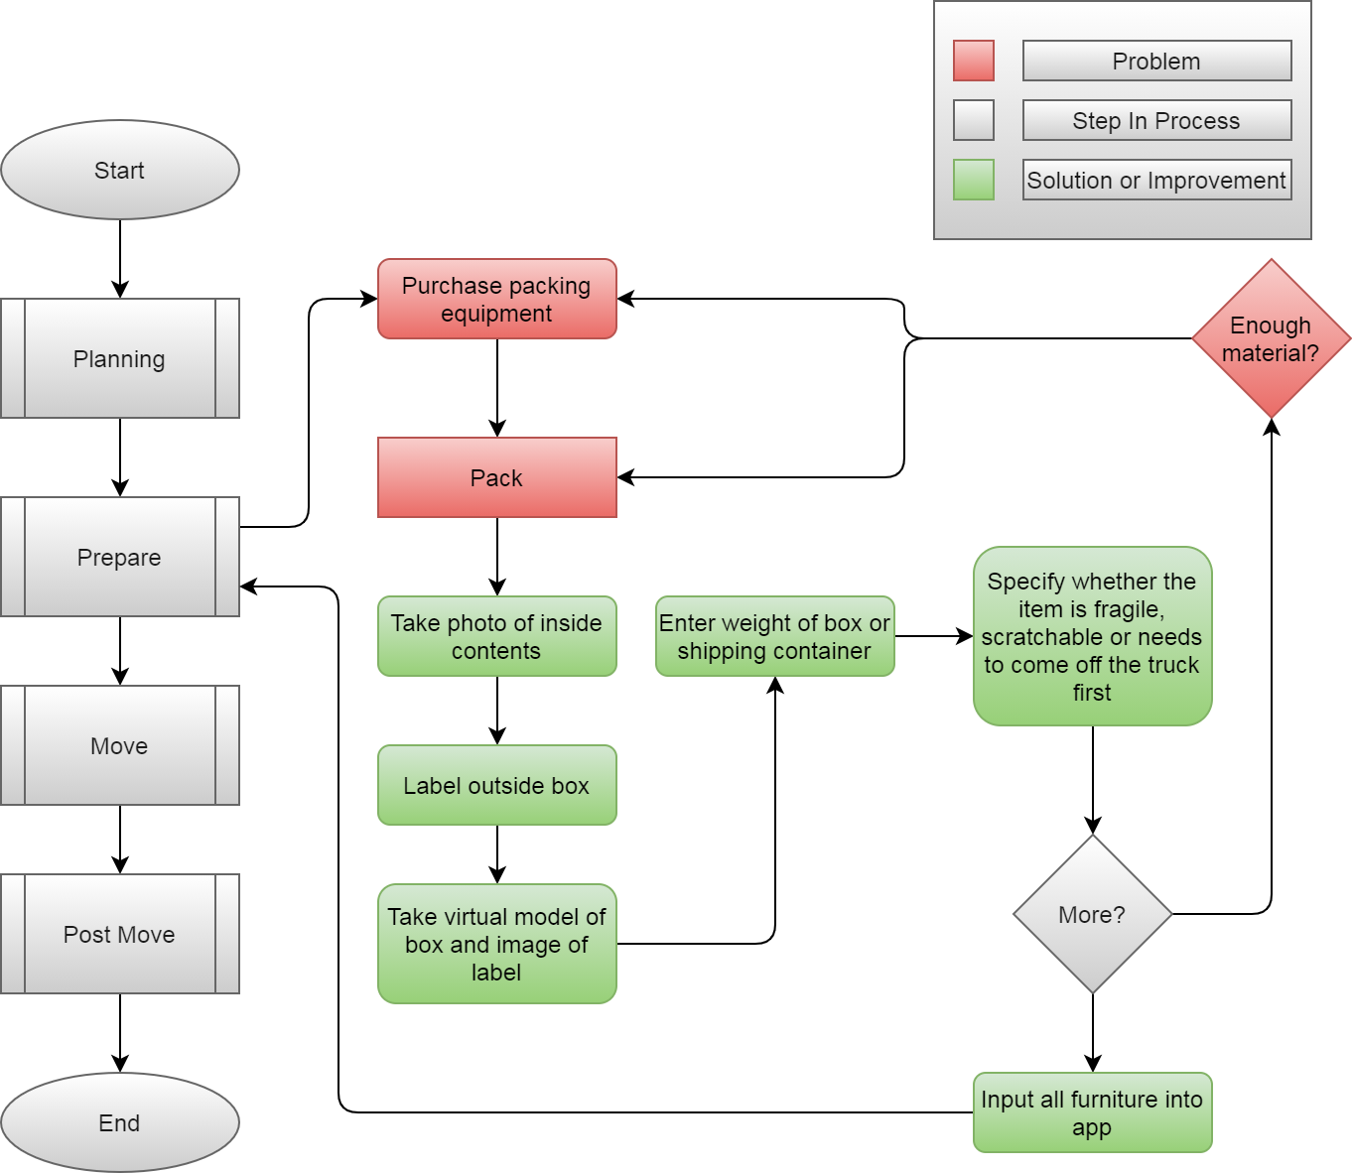

Slide 24
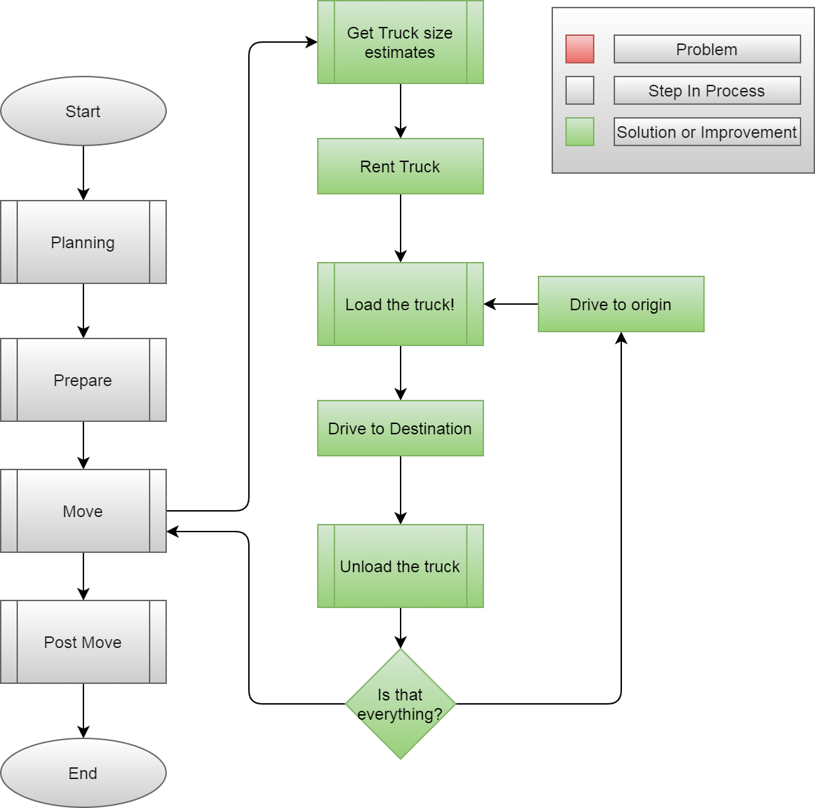

Slide 25
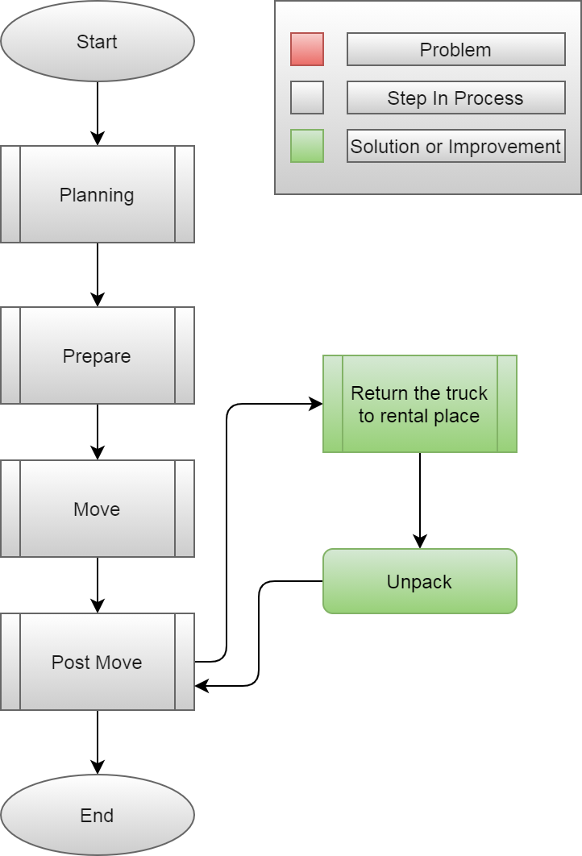

Slide 26
What are the major functional components?

Slide 27
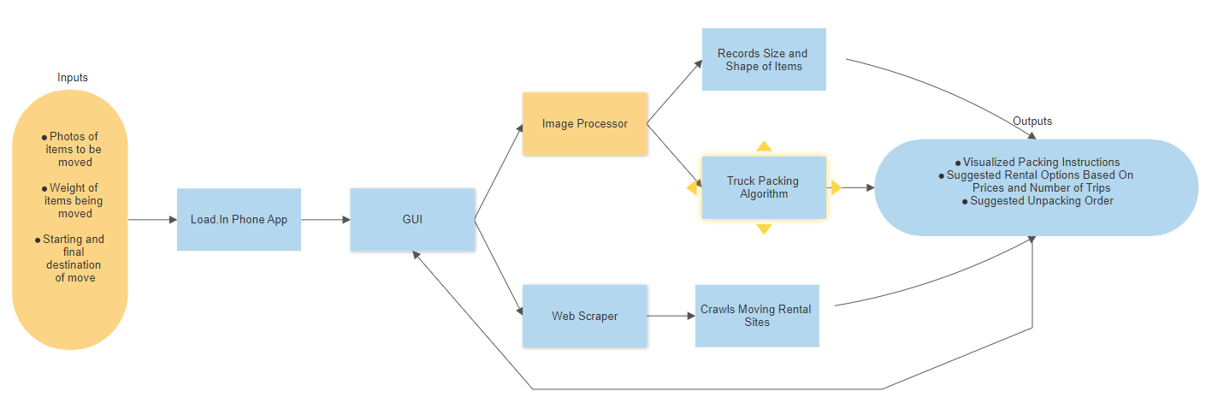

Slide 28
What’s the competition like?

Slide 29
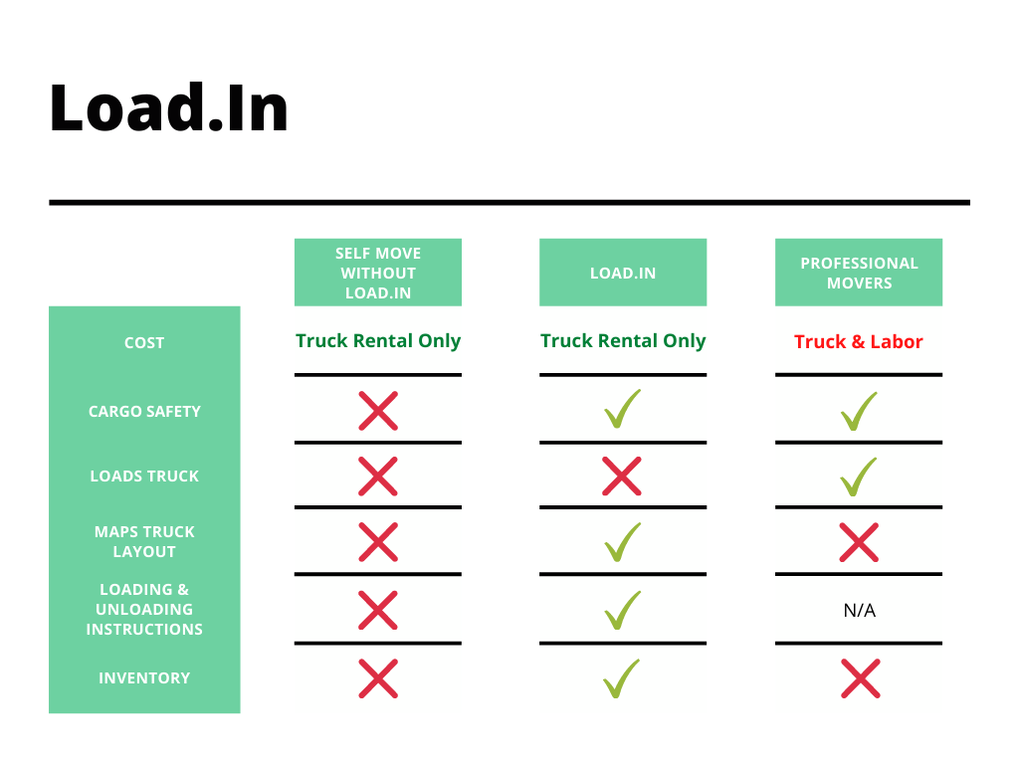

Slide 31
Sources:
The Top 5 Moving Mistakes Across America. (2019, August 13). Article. https://www.article.com/blog/top-5-moving-mistakes/
Economy Moving & Storage, LLC. (2015, January 4). How to properly pack and load a moving truck- Movers Cincinnati. YouTube. https://www.youtube.com/watch?v=rjmofUZOdwo&feature=youtu.be
CADCode Systems. (n.d.). Optimizing & Machining | CADCode Systems. CADCode.Com. Retrieved September 20, 2020, from https://www.cadcode.com/category/categories/optimizing-machining
Dube, E. (2020, September 20). OPTIMIZING THREE-DIMENSIONAL BIN PACKING THROUGH SIMULATION. Semantics Scholar. https://www.semanticscholar.org/paper/OPTIMIZING-THREE-DIMENSIONAL-BIN-PACKING-THROUGH-Dube/bb9986af2f26f7726fcef1bc684eac8239c9b853#references
Knoblauch, M. (2019, May 8). One in ten Americans would prefer a week in jail over moving. New York Post. https://nypost.com/2019/05/08/one-in-ten-americans-would-prefer-a-week-in-jail-over-moving/
The American Institute of Stress. (n.d.). The Holmes-Rahe Stress Inventory PDF. Retrieved September 20, 2020, from https://www.stress.org/wp-content/uploads/2019/04/stress-inventory-1.pdf
Wood, T. (2020, January 6). Moving Industry Statistics. MoveBuddha. https://www.movebuddha.com/blog/moving-industry-statistics/
Nat and Friends. (2017, April 18). Google Earth’s Incredible 3D Imagery, Explained. YouTube. https://www.youtube.com/watch?v=suo_aUTUpps&feature=youtu.be
Collins, T. (2018, April 20). A Look Into Photogrammetry and Video Games - Tiger Collins. Medium. https://medium.com/@homicidalnacho/a-look-into-photogrammetry-and-video-games-71d602f51c31

Slide 32
Glossary:
*All definitions are sourced from Wikipedia
Photogrammetry
Photogrammetry is the science and technology of obtaining reliable information about physical objects and the environment through the process of recording, measuring and interpreting photographic images and patterns of electromagnetic radiant imagery and other phenomena.
Algorithm
A finite sequence of well-defined, computer-implementable instructions, typically to solve a class of problems or to perform a computation.
Professional movers
Professionals who move all your belongings for you from one place to another.
Packing problems
Are a class of optimization problems in mathematics that involve attempting to pack objects together into containers. The goal is to either pack a single container as densely as possible or pack all objects using as few containers as possible.

